Slide 1
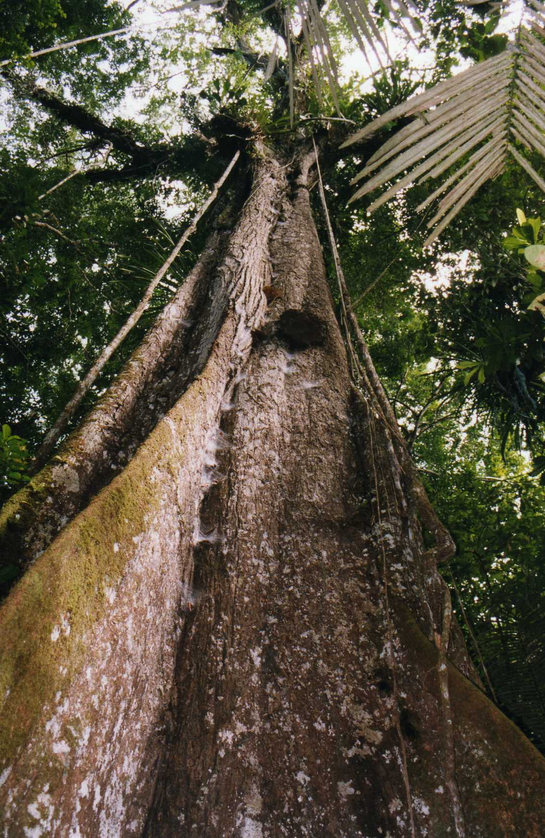
Photo: Leonora Enking

Slide 2
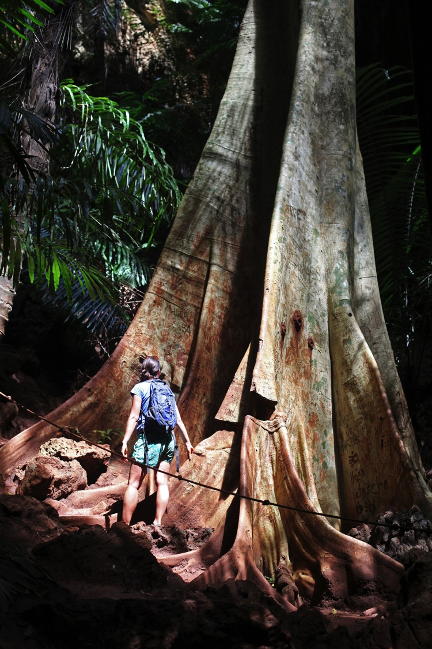
Photo: Yodod

Slide 3
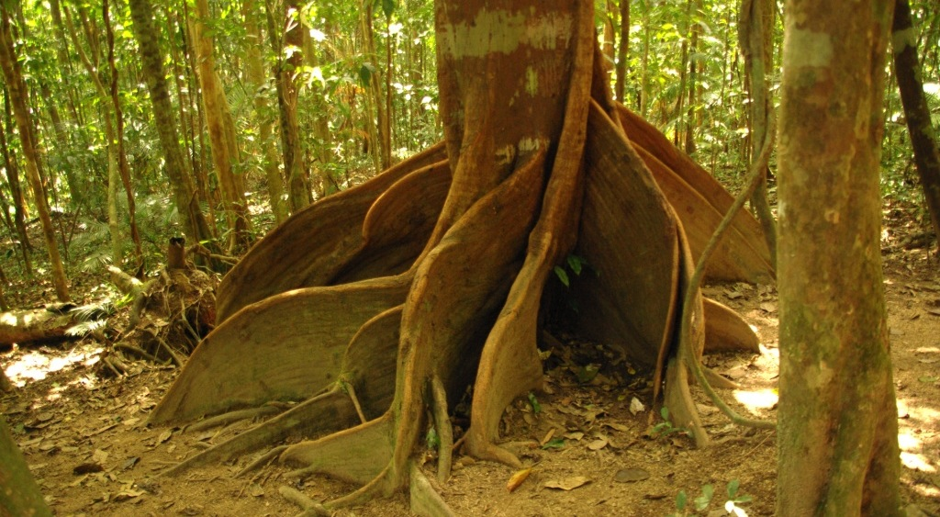
Buttress roots
Photo: Steve

Slide 4
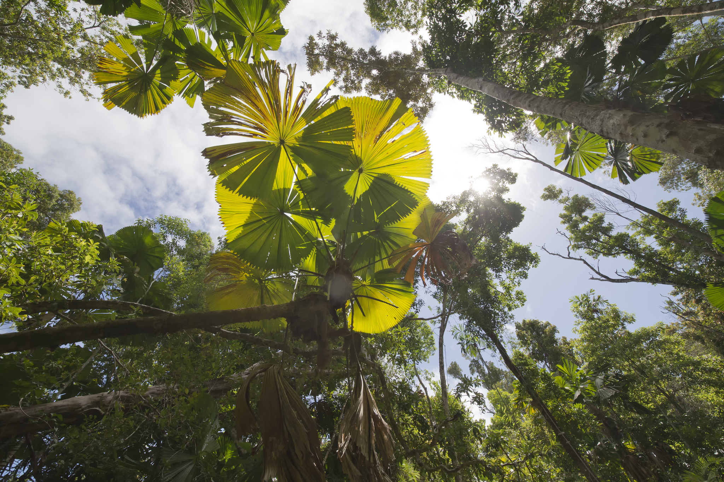
Fan Palms
Photo: Jim Bendon

Slide 5
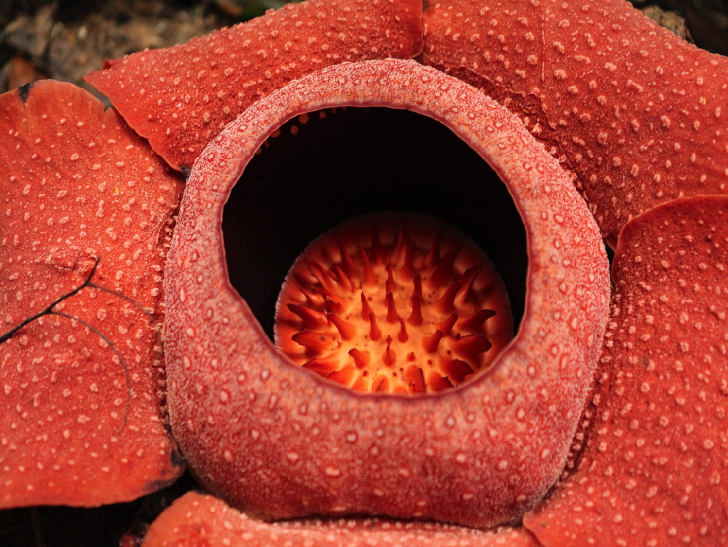
Rafflesia – the corpse flower
Photo: Brandon Shigeta

Slide 6
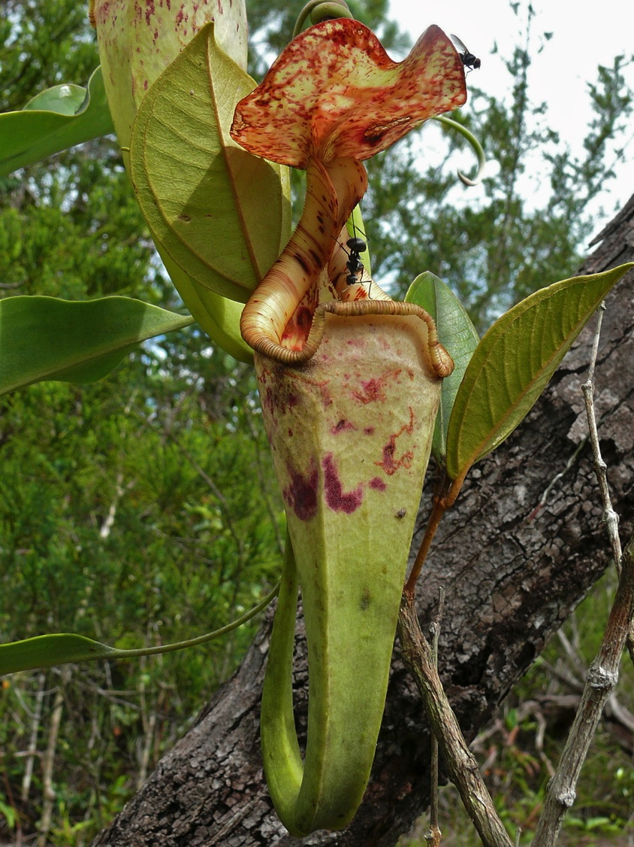
Pitcher plant
Photo: Bernard DUPONT

Slide 7
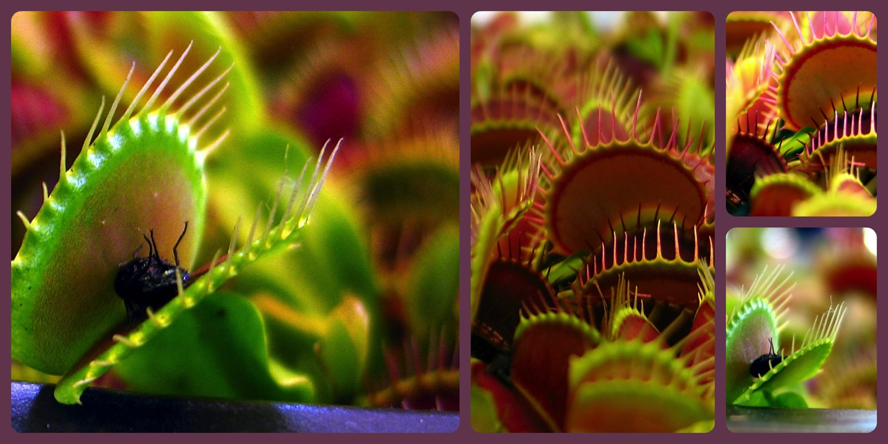
Venus flytrap
Photo: Heartlover1717

Slide 8
Credits
YPTE would like to thank all the amazing photographers on Flickr who allow the use of their photos for non-commercial purposes.
Your photos are helping young people to learn more about environmental issues. We couldn’t have created this presentation without you!

