Slide 1
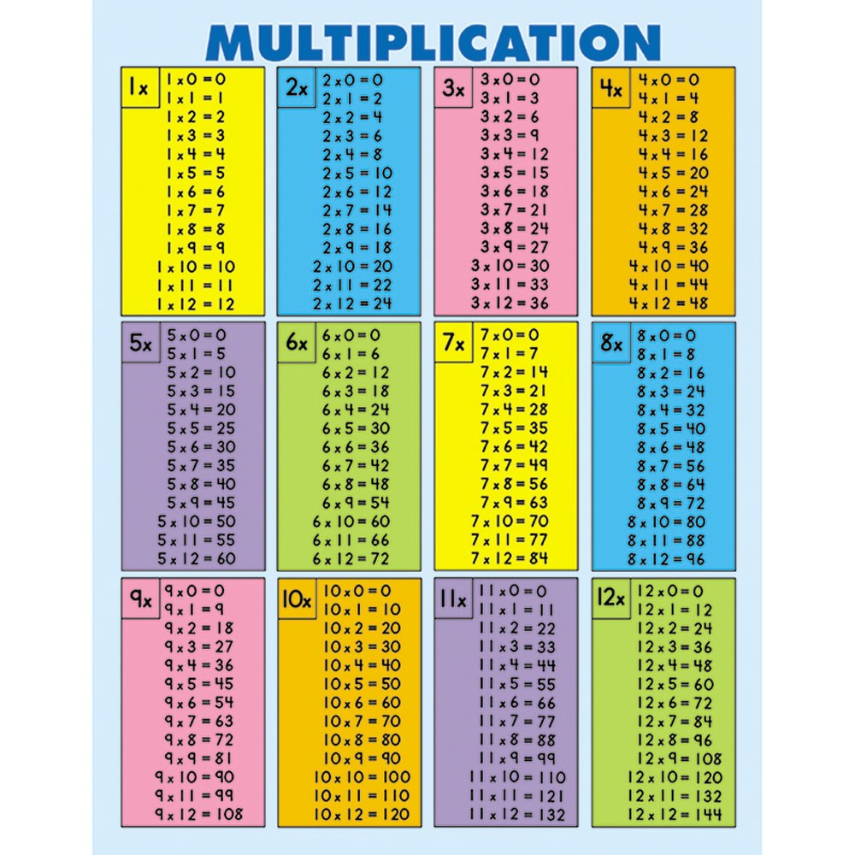
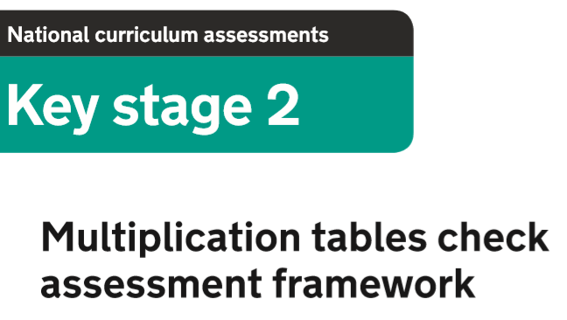


Slide 2
Purpose of the MTC
The purpose of the Multiplication Tables Check (MTC) is to determine whether year 4 pupils can fluently recall their multiplication tables.
National curriculum: By the end of year 4, pupils should have memorised their multiplication tables up to and including the 12 multiplication table and show precision and fluency in their work.
Y4 programme of study for maths: Pupils should be taught to recall multiplication and division facts for multiplication tables up to 12x12.
(NB. The MTC will only assess the instant recall on multiplication facts.)

Slide 3
What will the MTC look like for children?
An online, on-screen digital assessment (tablet or computer).
Less than 5 minutes to complete.
25 questions with 6 seconds per question.
Questions will take the form of: A x B = C (eg: 4 x 3 = 12)
Each test is randomly assigned to a child, so no two tests are the same.
Children can click ‘enter’ after inputting their answer, or they can simply wait for the 6seconds to pass and whatever answer they’ve inputted will be taken.
There will be a 3 second pause between each question.

Slide 4
The MTC
The children are not allowed any other resources to support them with the MTC (eg: multiplication charts or grids).
The MTC is automatically scored and the results will be available to schools after the assessment window for administrating the test closes.
There will be no expected standard threshold for the MTC.
The main focus is on children recalling multiplication facts quickly and fluently.

Slide 5
The MTC finer details
Voluntary check in 2018-19
Assessment window for voluntary pilot: 10th to 28th June 2019.
Statutory for 2019-2020 onwards (every June).
All pupils are required to take the check.

Slide 6

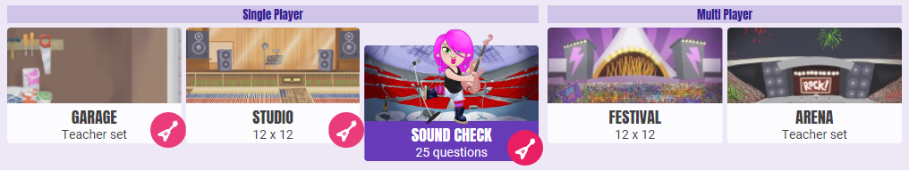
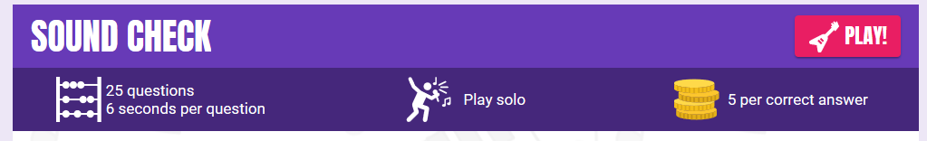
The MTC and TT Rockstars
TT Rockstars ‘SOUNDCHECK’ game for Y4 pupils replicates the similar format of 25 questions with 6 seconds to answer each.

