Slide 1

Language and Literacy Meeting
19th October 2023

Slide 2


Slide 3
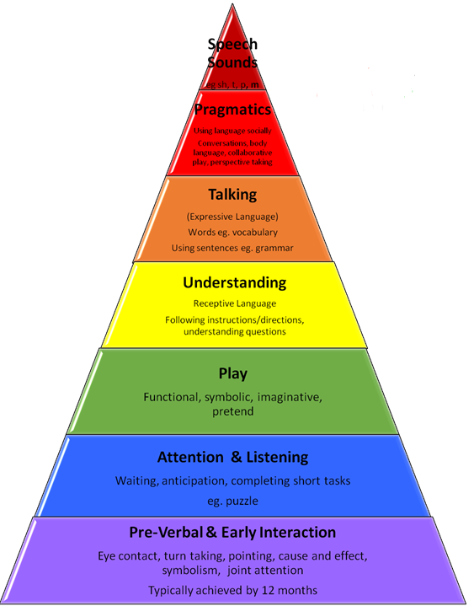
Try building up the length of stories your child listens to. By the end of Foundation most children will be able to listen to and follow a short story without pictures. Audio books are great.

Slide 4
We work a lot on answering and asking questions in Foundation. Can your child answer a range of what, where, when, why, how questions?

Slide 5
Recasting, or correcting by modelling is an important tool in language development.
Child “We was doing painting” Adult “Yes we were, we were doing painting today”. Or “Were you, what were you painting?”

Slide 6
Children’s speech sound development is checked when they begin school. Speech sounds typically develop at different ages but a child’s ability to hear or say sounds correctly is vital to developing their phonics.

Slide 7
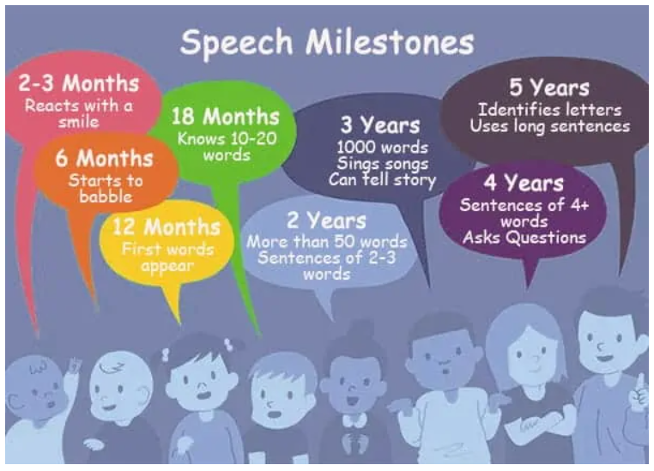

Slide 8
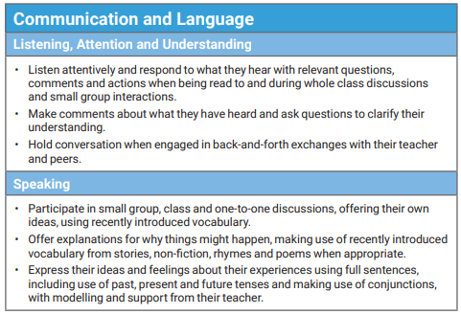
Communication and language
What are we aiming for by the end of Foundation?

Slide 9



Finding a love of books and stories

Slide 10


Letter sounds rather than names (phonemes)
“sssss” rather than “suh”
Why?
These sounds are easier to blend together to read.
E.g. cat
We teach initial (single alphabet) sounds first in order of relevance. Children must be able to correctly say the sound, recognise it and write it.

Slide 11
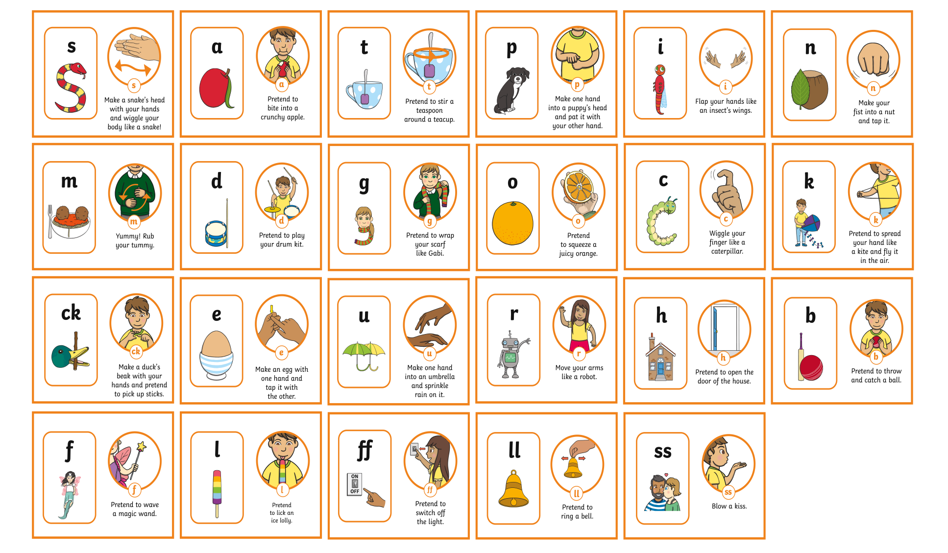
Level 2 https://www.youtube.com/watch?v=0SzkjubQ-Ok

Slide 12
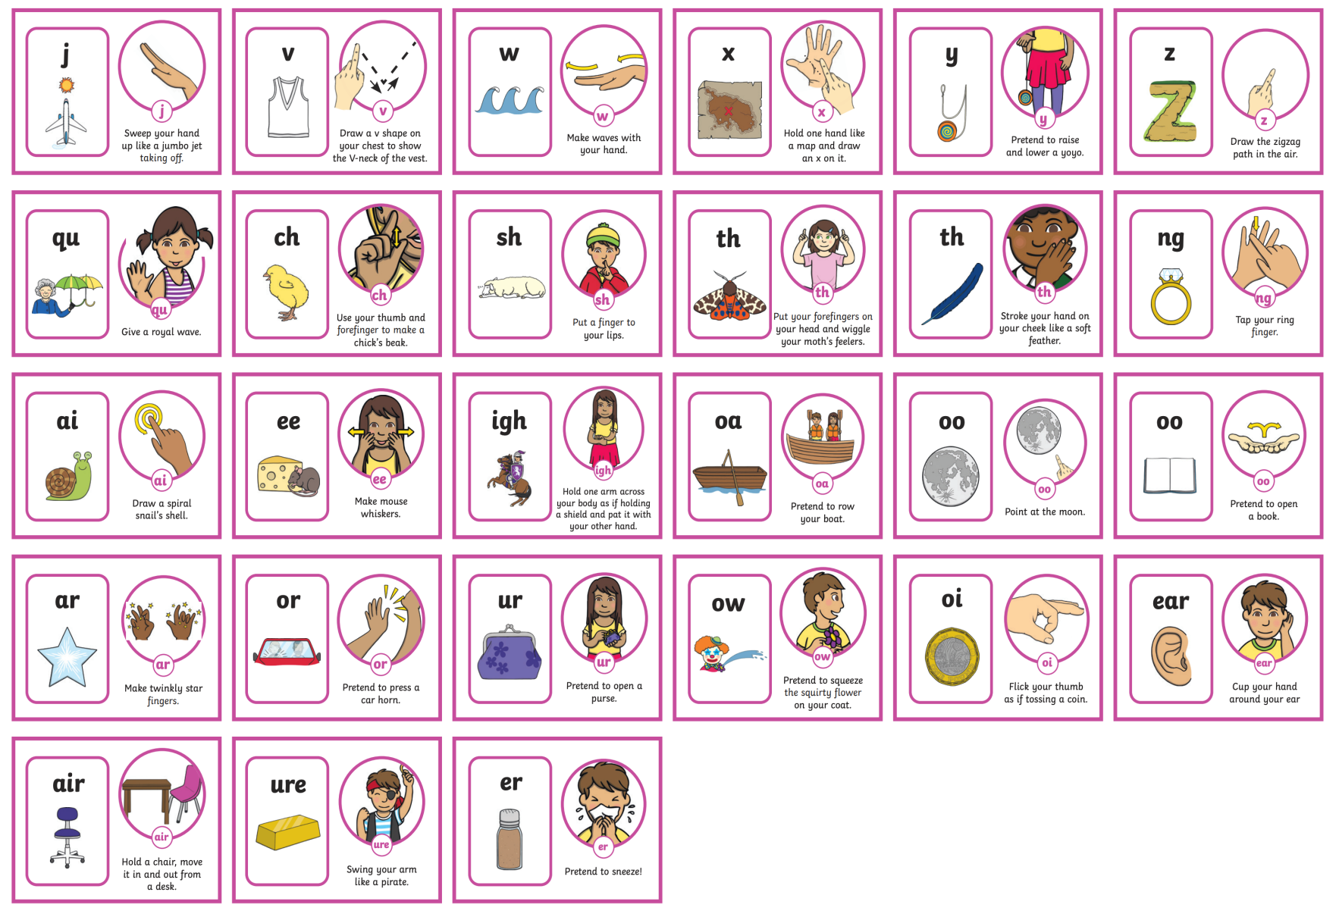
Level 3

Slide 13
https://www.twinkl.co.uk/resource/t-l-526744-a-lesson-pack-level-2-week-1-lesson-2

Slide 14
Digraphs
Sounds with 2 letters!
sh shop
ow cow

Slide 15
Trigraph
Sounds with 3 letters!
ear beard
igh night

Slide 16
Tricky words
Not all words can be broken down into phonic sounds...
Regular words | Tricky words
frog train can sit | the no go to I into

Slide 17
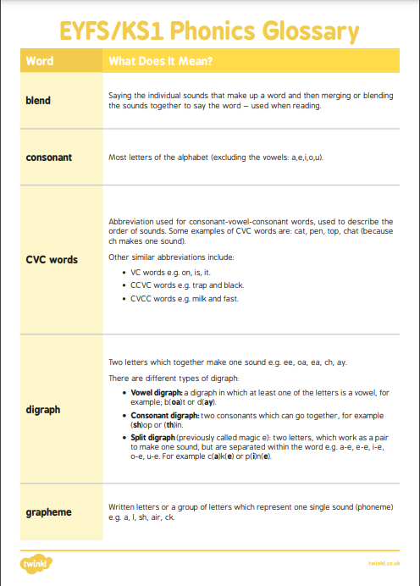
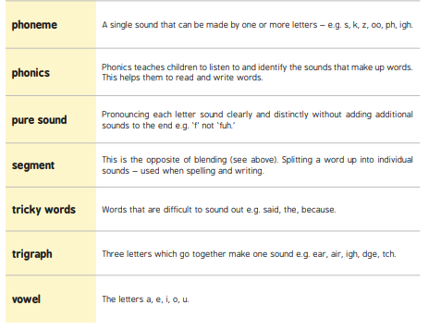

Slide 18

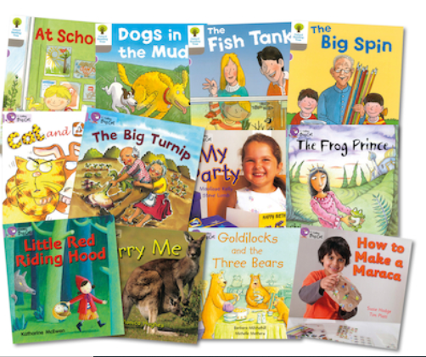
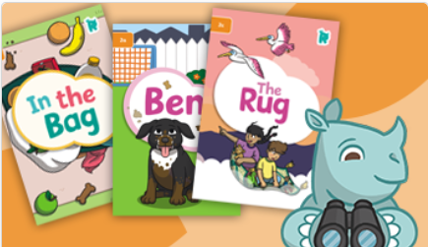

Slide 19
https://www.twinkl.co.uk/go/resource/level-2b-reading-scheme-book-the-sock-t-e-2553343
Access this lesson using pin code: NL5846
at Twinkl Go

Slide 20
Choose somewhere quiet to read with as few distractions as possible. The end of the day when the children are tired is often not the best time.
-Allow your child time to try to work out the words for themselves before you step in to help, unless the word is one of their unknown tricky words. Encourage children to “sound it out” themselves and then try repeating back the sounds several times to assist your child in hearing those sounds blended together, t-a-g, t-a-g, tag.
Ask the children to re read the whole sentence once they have read or sounded out each individual word to assist their understanding.
Ask questions about the story at the end. Often children learn to read the words but do not understand or take in what they have read.

Slide 21
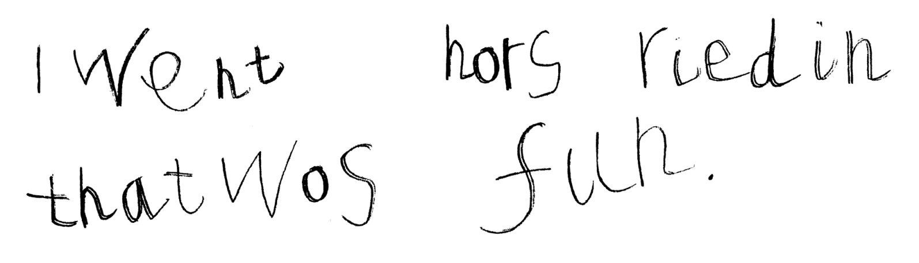
Writing
We encourage children to think for themselves when writing and to write using the sounds and tricky words they know. It is important that they begin to think of themselves as confident writers. Of course we are there to help them and improve their writing but the children do not learn to rely on copying our writing.

Slide 22
Thank you for coming

